Slide 1
The Workings of Mind and Body
Body and Behaviour
Altered States of Consciousness
Sensation and Perception

Slide 2
What do you know about Psychobiology?
Anatomy = structure
Physiology = function

Slide 3
Body and Behaviour

Slide 4
The Nervous System
Central Nervous System (CNS) = brain + spinal cord
Spinal cord = nerves that run up and down the length of the back and transmit most messages between brain and body
Peripheral Nervous System (PNS) = nerves branching out from spinal cord

Slide 5
Peripheral Nervous System
Somatic controls voluntary movement of skeletal muscles
Autonomic controls internal biological functions (heart rate, breathing, blood pressure, digestion, etc.)
Sympathetic prepares body for emergencies or strenuous activity
Parasympathetic conserves energy and recovers

Slide 6
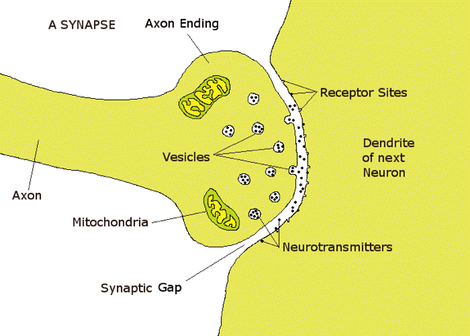
Neurons
Neurons = nerve cells
Synapses = gaps between neurons

Slide 7
Neurotransmitters
Chemical | Physiology | Results if under/over supply
Endorphin | inhibits pain | none
Acetylcholine | movement & memory | Paralysis / Alzheimers (under)
Norepinephrine | memory & learning | Depression (under)
Dopamine | learning, emotional arousal, movement | Schizophrenia (over) Parkinsons (under)
Serotonin | mood, sleep, appetite, temperature | Depression / violence (under)
Chemicals released by neurons that determine the rate of firing

Slide 8
Quiz 6-1

Slide 9
We have 3 Brains

Slide 10
Hindbrain
Cerebellum: posture, balance, voluntary movement
Medulla: breathing, heart rate, reflexes
Pons: bridge between spinal cord and brain, produces sleep chemicals

Slide 11
Midbrain
Integrates sensory information and relays it upward
Brainstem (spinal cord + hindbrain + midbrain) covered by Reticular
Activating System: alerts brain to incoming signals, controls sleep cycle

Slide 12
Forebrain
Limbic system:
Thalamus: integrates & relays sensory information (except smell)
Hypothalamus: body temperature, hunger, thirst, sex
Amygdala: violent emotions
Hippocampus: forming new memories
* 80% of the brain by weight
http://bigthink.com/videos/from-nose-to-brain-the-neurology-of-smell

Slide 13
Forebrain
Cerebrum: divided into 2 hemispheres
Left: verbal, mathematical, analytical, right side of the body
Right: non-verbal, spatial & visual relations, patterns, creativity/intuition, left side of the body
Corpus Callosum: membrane separates hemispheres
May be severed to control epileptic seizures (massive uncontrolled electrical activity)
90% of population right handed
Most primitive tools right handed

Slide 14
Forebrain
Cerebral Cortex (outer layer): learning, memory, reading, abstract information
Lobes:
Occipital: vision
Parietal: body senses
Temporal: hearing, memory, emotion, speaking, advanced visual processing
Frontal: organization, planning, creative thinking, working memory
Most violent criminals have abnormal
frontal lobe

Slide 15
Studying the Brain
Methods used to study the brain:
Stimulation (memory, smell)
Lesions (monkeys, lobotomy)
Accidents (Phineas Gage)
Recording (EEG)
Imaging (CAT, PET, MRI)

Slide 16
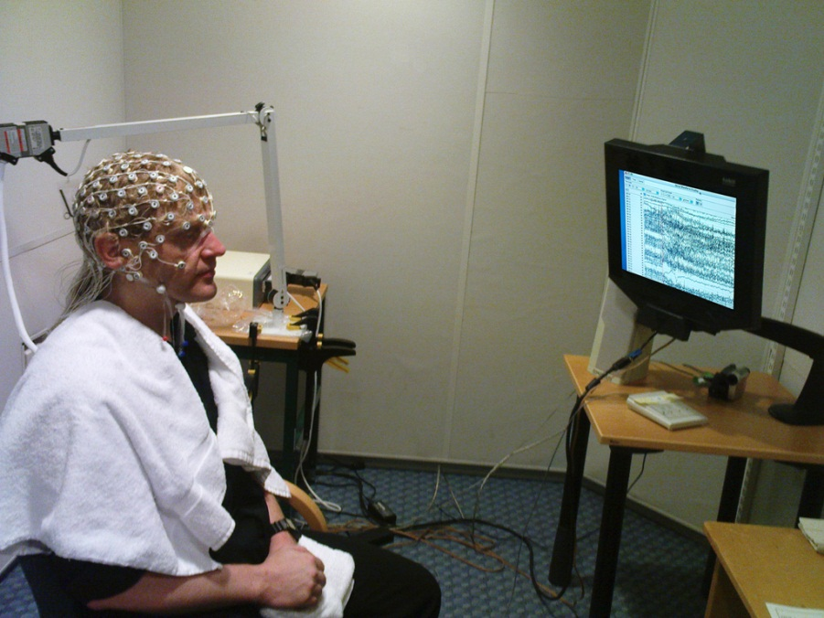
EEG
Electroencephalograph (EEG):
Machine used to record electrical
activity
Overall activity rises and falls
rhythmically in waves
Pattern depends on state of
consciousness

Slide 17
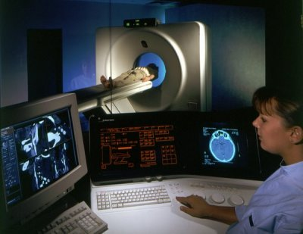
CAT
Computerized Axial Tomography (CAT):
Machine used to pinpoint injury / brain
deterioration
Uses x-ray beam absorption

Slide 18
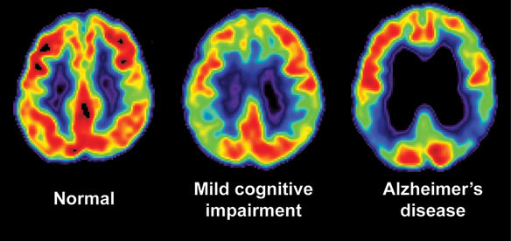
PET
Positron Emission Tomography (PET):
Machine used to see which areas of the
brain are active while performing tasks
Radioactive dye is injected into the
bloodstream

Slide 19
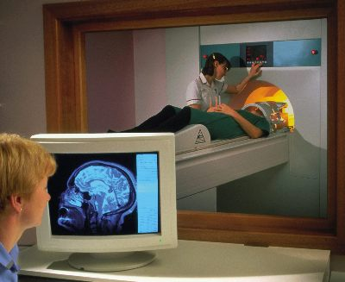
MRI
Magnetic Resonance Imaging (MRI):
Machine used to study brain structure
and activity
Helps to locate tumors or brain damage
Non-harmful radio frequencies pass
through the brain

Slide 20
Quiz 6-2

Slide 21
The Endocrine System
Chemical communication system
Endocrine glands (ductless glands) release hormones directly into bloodstream
Pituitary gland is center of control, secretes lots of hormones, controls growth, water & salt metabolism

Slide 22
Hormones
Hormone | Gland | Influences
Thyroxine | Thyroid | metabolism
Adrenaline | Adrenal | Heart rate, breathing, emotions
Testosterone | Testes | male physical & sexual
Estrogen | Ovaries | female physical & sexual
Progesterone | Ovaries | menstrual cycle, PMS, pregnancy
Endocrine system uses hormones to send messages through the bloodstream
Hormones are chemicals that carry a message (some chemicals are also neurotransmitters)
Adrenal glands also produce
cortical steroids.
Adrenaline = Epinephrine

Slide 23
Quiz 6-3

Slide 24
Heredity & Environment
Heredity = genetic transmission of characteristics from parents to their offspring
Genes = basic building blocks of heredity

Slide 25
Twins
Identical: Monozygotic (one fertilized egg) – same heredity
Fraternal: Dizygotic (two different eggs fertilized by two different sperm) – heredity like any siblings

Slide 26
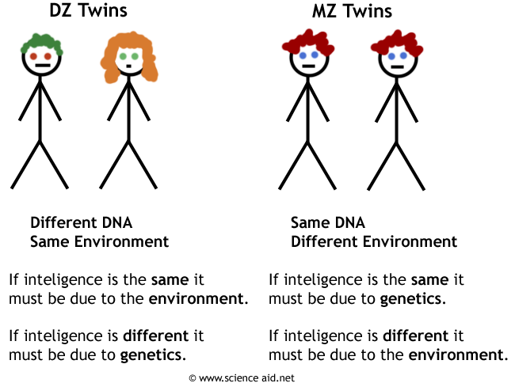
Nature vs Nurture
Sir Francis Galton
John Watson

Slide 27
Quiz 6-4

Slide 28
Altered States of Consciousness

Slide 29
Consciousness
Consciousness = state of awareness, including feelings, sensations, ideas and perceptions
Circadian Rhythm = rhythm of daily activity and inactivity (internal clock)
Accidents increase 8% when DST starts (sleep deprivation – traffic accidents, Three Mile Island, Chernobel, Exxon
Altered state = change in mental processes (sensations, perceptions, thoughts)

Slide 30
Sleep
Why do we sleep?
Restorative / “recharge batteries”
Hibernation / conserve energy
Adaptation / survival
Clear the mind
Process information / solve problems
We spend 1/3 of our lives asleep.
How many years is that so far?

Slide 31
What’s altered when we sleep?
Stage | Brain wave type | Amplitude | Frequency (cycles/sec.)
Transitioning | Alpha | Low | 8-12 Hz
NREM 1 | Theta | Low | 6-8 Hz
NREM 2 | Theta | Higher | 4-7 Hz
NREM 3 | Delta | Higher | 1-4 Hz
NREM 4 | Delta | High | Close to 1 Hz
REM | Alpha | Low | 8-12 Hz
REM 15-45 minutes/cycle
What happens while “falling” asleep?
3-4 cycles/night
75% NREM sleep

Slide 32
The Sleeping Brain

Slide 34
To sleep, perchance to live
Stage 4 (deepest) sleep necessary – body will catch up if short – hard to wake (panic, confusion)
DJ Tripp’s New York fundraiser:
50 hours – hallucinations
100 hours – delirium
120 hours – needed stimulant to stay awake
150 hours – disorientation
200 hours – sinister hallucinations, ended

Slide 35
…perchance to dream
Dreaming usually during REM sleep
REM sleep discovered by Kleitman and Dement
Dreams are realistic time (not split second)
Dreams are mental housekeeping - remove unneeded memories (Francis Crick)
Even mundane dreams hold meaning (Freud)
Interpretations since 5000 BC
Prehistoric people thought soul left body during sleep
Inuit people believe dreamers enter spirit world
Even daydreaming is good -> creativity

Slide 36
Quiz 7-1

Slide 37
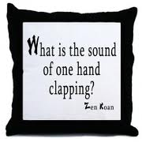
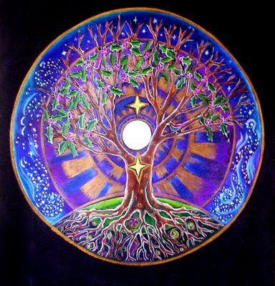
Meditation
Focusing attention to clear mind and relax
Transcendental:
Mantra = repeated phrase (Sanskrit)
Koan = unsolvable riddle / question
Mandala = complex image

Slide 38
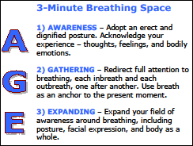
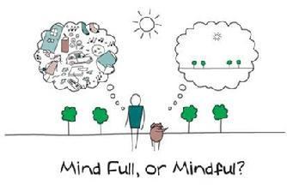
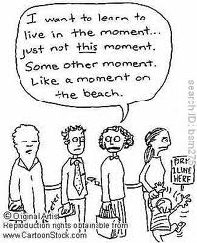
Meditation
Breathing
Mindfulness (focus on present)

Slide 39
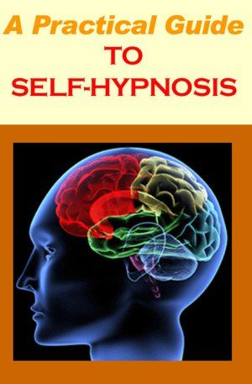
Hypnosis
State of consciousness in which attention is narrowly focused and responsive to suggestion
Patient cooperates with hypnotist…not controlled by
Posthypnotic suggestion made during hypnosis influences behavior afterward
Ernst Hilgard’s Neodissociation theory:
People who are hypnotized are suggestible
Consciousness has many different aspects which may become separated or dissociated
Self-hypnosis = self induced state of hypnosis (patient retains control and responsibility)

Slide 40
Hypnotic Analgesia
Pain reduction after hypnosis
May be used to manage pain not reduced by other treatments or even conduct surgery

Slide 41
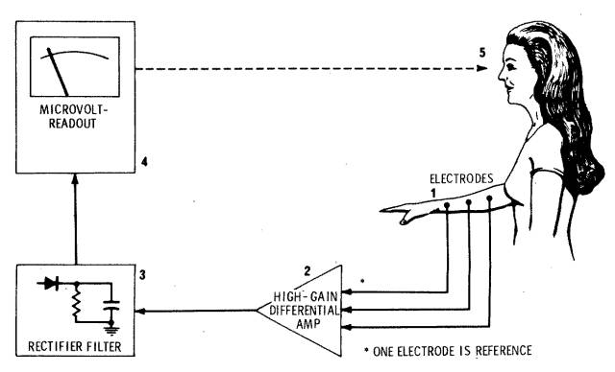
Biofeedback
Process of learning to control bodily states with the help of machines monitoring them:
Brain waves
Heart rate
Blood pressure
Skin temperature
Sweat
Success treating asthma & migraines

Slide 42
Quiz 7-2

Slide 43
Sensation and Perception

Slide 44
Sensation and Perception
Sensation = stimulus activates a receptor
Psychophysics = study of relationship between sensory experiences and physical stimuli that cause them
Perception = organization of sensory information into meaningful experiences

Slide 45
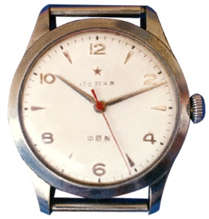
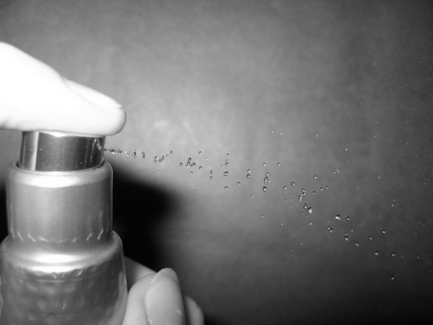
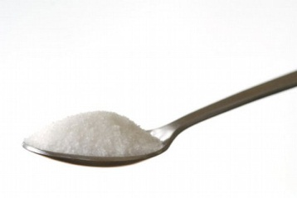
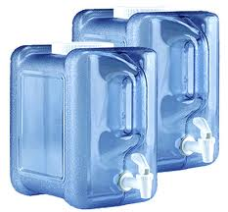
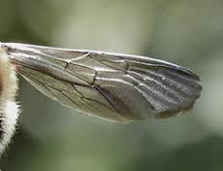
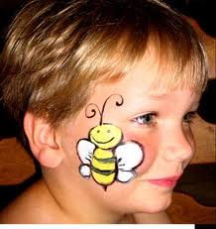
Absolute Threshold
Vision | Flame 30 miles clear night
Hearing | Watch tick 30 feet
Smell | 1 drop perfume 3 room house
Taste | 1 tsp. sugar 2 gallons water
Touch | Bee wing fall 1 cm onto cheek
Weakest amount of a stimulus that can be detected half the time

Slide 46
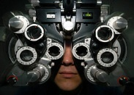
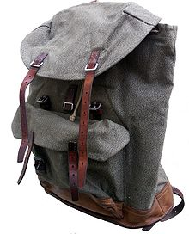
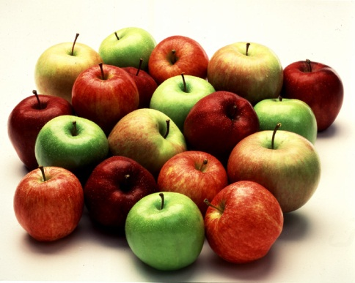
Difference
Difference threshold = minimum difference detected between two stimuli
Just noticeable difference = minimum change in intensity of a stimulus a person can detect
Weber’s Law = the larger/stronger the stimulus, the larger the change required for a difference to be noticed
Voltage +2X -> Shock +8X
Light up +3X -> Brightness +1X

Slide 47
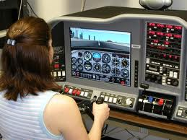
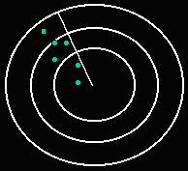
Signal detection
Signal detection theory = tendency to make correct judgements in recognizing a stimulus against background of competing stimuli
Pre-attentive process = method of automatically extracting information from a stimulus
Attentive process = consider one part only

Slide 48
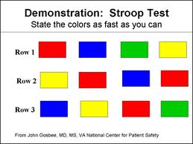
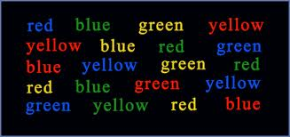
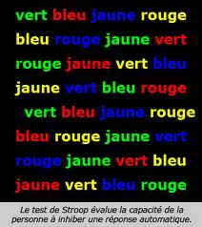
Stroop effect

Slide 49
Sensory adaptation
Skin adapts to cold pool
Stop noticing perfume

Slide 50
Quiz 8-1

Slide 53
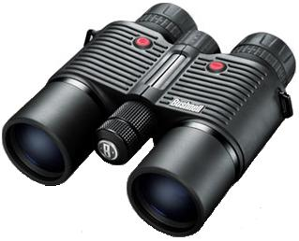
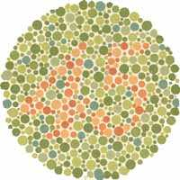
Vision
Pupil regulates amount of light entering eye
Lens changes shape to focus light on retina
Retina has 75-150 million rods (low light receptor cells) and 6-7 million cones (high light color receptor cells)
Color blind 8%M 1%F (most R/G, some Y/B)
Blind spot where optic nerve adjoins retina
Binocular fusion combines images from 2 eyes into single focused image
Retinal disparity (difference between image received by each eye) produces depth perception

Slide 55
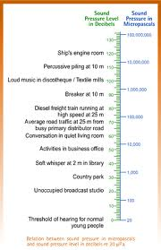
Hearing
Stimulated by sound waves:
Not electromagnetic
Frequency of vibration produces pitch
Sound pressure energy measured in decibels

Slide 56
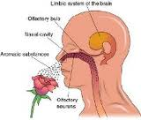
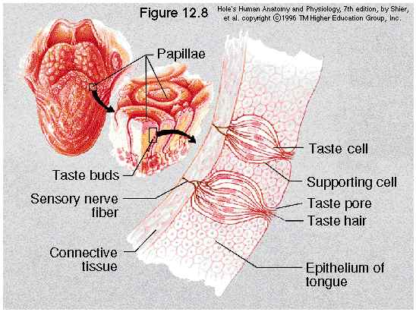
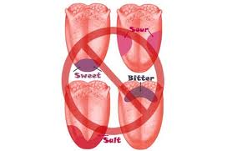
Chemical Senses
Smell: volatile (airborne) substances stimulate olfactory membrane and send impulses through olfactory nerve
Taste: Soluble substances stimulate taste buds and send impulses through sensory nerves

Slide 57
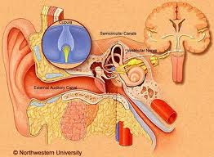
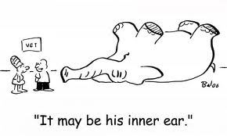
Balance
Vestibular system (balance):
Semi-circular canals in inner ear contain fluid and hairs
Movement of fluid stimulates hair cells and overstimulation produces dizziness / motion sickness

Slide 58
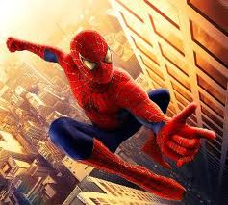
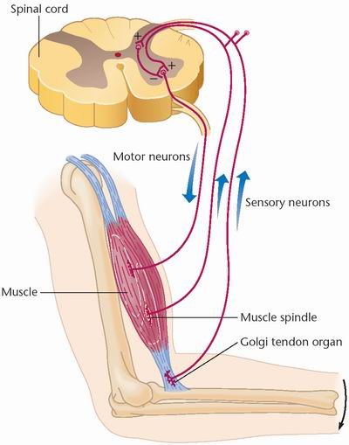
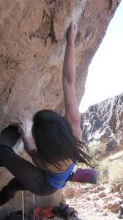
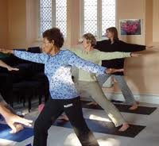
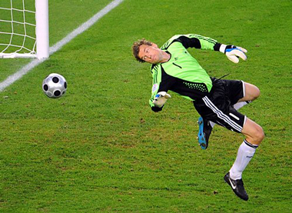
Kinesthesis
Sense of movement and body position

Slide 59
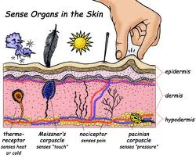
Skin Senses
Gate control theory of pain = shift attention away from pain impulses to create competition

Slide 60
Quiz 8-2

Slide 61
Gestalt
Organizing bits of information into a whole

Slide 62
Figure-Ground Perception
Discrimination between a figure and its background
Or selecting one voice in a crowd
Or selecting one instrument in the orchestra

Slide 63
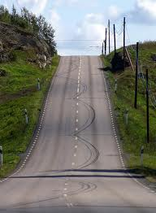
Perceptual Inference
Filling in the gaps in what our senses tell us

Slide 64
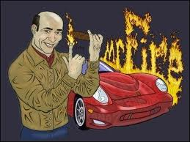
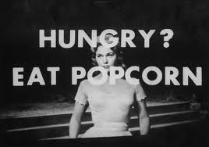
Subliminal Messages
Brief auditory or visual messages presented below the absolute threshold

Slide 65
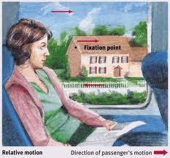
Depth Perception
Monocular cues:
Relative height
Interposition
Light and shadow
Texture-density gradient
Motion Parallax
Linear perspective
Relative motion

Slide 66
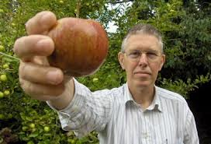
Constancy
We perceive objects the same way regardless of angle, distance or lighting

Slide 67
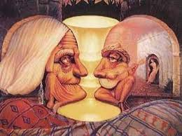
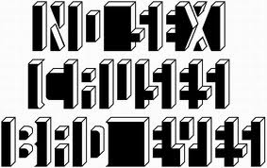
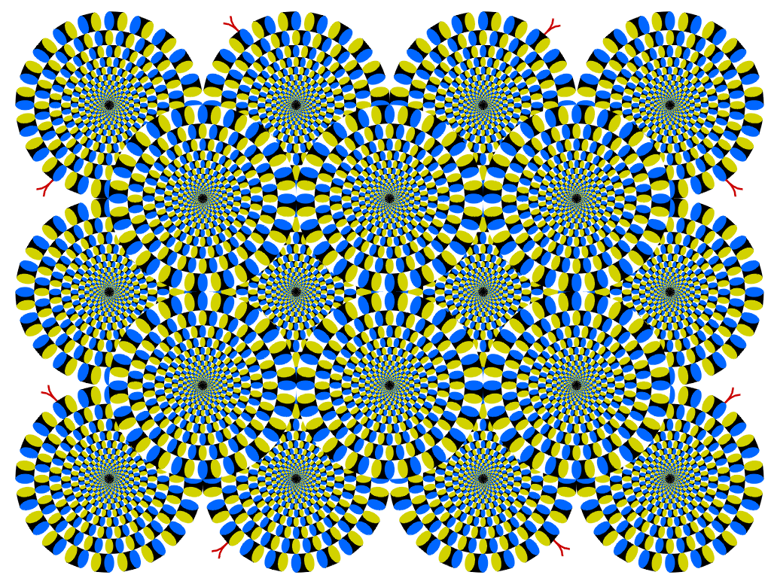
Illusions
Perceptions that misrepresent physical stimuli

Slide 68
Extrasensory Perception
Gaining information from other than usual senses:
Clairvoyance – perceive objects or information
Telepathy – read / transfer thoughts
Telekenesis – move objects
Precognition – foretell events

Slide 69
Quiz 8-3

