Slide 1
Learning and cognitive processes
Learning: Principles and Applications
Memory and Thought
Thinking and Language
Motivation and Emotion

Slide 2
Learning Outcomes
LEARNING Define learning from a psychological viewpoint. Describe the classical conditioning paradigm. Describe the operant conditioning paradigm. Explain observational and cognitive learning approaches. Discuss the roles of biology and culture in determining what behaviors will be learned. | MEMORY Describe encoding, or getting information into memory Describe sensory, working or short-term, and long-term memory systems. Describe retrieval, or getting information out of memory. Describe strategies for improving memory.

Slide 3
Learning Outcomes
THINKING AND LANGUAGE Define thinking as a mental process involved in the manipulation and understanding of information. Identify that information is classified into categories containing similar properties known as concepts Explore the different strategies and obstacles involved in problem solving and decision-making Discuss language acquisition across species. | MOTIVATION AND EMOTION Apply motivational concepts to the behavior of humans and other animals. Investigate the role of biology and learning in motivation and emotion Describe the theories of motivation, such as expectancy value, cognitive dissonance, arousal, Maslow's hierarchy of needs, and drive reduction. Discuss cultural factors in emotions and motivations Describe theories of emotion, such as James-Lange, Cannon-Bard, or cognitive theories and account for how emotions and behaviors are related.

Slide 4
Classical conditioning
Learning = relatively permanent change in behavior that results from experience
Plato believed association is the key to learning and memory
Classical conditioning = learning procedure in which associations are made between a neutral stimulus and a natural stimulus

Slide 5
Classical conditioning
GO9
Type of Stimulus | Description
Neutral | No initial response elicited
Unconditioned (UCS) | Predictable response elicited
Conditioned (CS) | Once neutral, trained to elicit desired response

Slide 6
Classical conditioning
GO9
Type of Response | Description
Unconditioned (UCR) | Natural reaction to a stimulus
Conditioned (CR) | Learned reaction to a conditioned stimulus (CS)
Experiment - green or purple pen?

Slide 7
Classical conditioning
The Trouble with Tuna:
Brian was hungry. His mother packed a tuna sandwich for his lunch. The mayonnaise had been left out too long and spoiled. After eating, Brian felt nauseated and ran to the bathroom. Now the mention of tuna makes Brian feel sick.
UCS: eating rotten food UCR: illness
CS: mentioning tuna CR: illness
A Hot Day at the Water Park:
Jeanette was excited about going to the water sports show. It was a very hot day, over 40 C. The show was exciting with contestants performing to blaring organ music. After watching for a time, Jeanette became hot & sweaty, then fainted. Now just hearing organ music makes her dizzy.
UCS: heat UCR: fainting
CS: organ music CR: dizziness

Slide 8
Classical conditioning
CR acquired gradually over time
Strongest association formed when CS presented just before UCS
Can a CR occur with a similar CS?
Little Albert’s fear of rats generalized to all furry things
Fear of all furry things discriminated to just rats
Does conditioning last forever?
Stop reward and CR dies out – extinction
Re-Pair CS and UCS and comes back – spontaneous recovery

Slide 9
Classical conditioning
GO9
Type of Response | Description
Generalization | Similar stimuli elicit CR
Discrimination | Respond differently to similar stimuli
Extinction | Gradual disappearance of CR when CS repeatedly presented without UCS
Spontaneous recovery | Reappearance of extinct CR when CS re-paired with UCS

Slide 10
Classical conditioning & human behavior
What types of human behavior can be classically conditioned?
Taste aversions (chemotherapy patients, rats & flavored water, coyotes & sheep sickness drug)
Fears (PTS after car accident, police siren after speeding ticket)
Tension (dentist drill)
Favorable feelings (advertising)
Benefits?
Helps humans predict behavior
Useful in child rearing, animal training…
Eliminate problems (bed wetting alarm, conquer fears)

Slide 11
Quiz 9-1 comparing and contrasting (ctsa 9)

Slide 12
Operant conditioning
Sheldon Cooper in action
Self-starving mental hospital patient
Feeding a stray dog

Slide 13
Operant conditioning
Operant Conditioning = learning in which an action is punished or reinforced, resulting in increasing or decreasing occurrence

Slide 14
Operant conditioning
What types of rewards influence behavior?
Animals – food, activities, attention…
People – money, privileges, social approval…
Are all positive reinforcers the same?
Primary – food, water, sleep
Secondary – money to buy food
What’s the best schedule for reinforcement?
Continuous – behavior maintained only while reinforced
Partial – slower to develop but more stable & long lasting
Ratio schedules based on number of correct responses
Interval schedule based on amount of time between reinforcement

Slide 15
operant conditioning
GO9 (add a row)
Type of Reinforcement | Description
Positive | Reward for desired behavior
Negative | Removal of unpleasant consequence for desired behavior
Punishment | Unpleasant consequence for undesired behavior
Primary | Satisfies biological need
Secondary | Acquired value through pairing with primary reinforcer

Slide 16
operant conditioning
GO9
Schedule of Reinforcement | Description
Fixed interval | Regular points in time
Variable interval | Time between unknown
Fixed ratio | After specified number of responses
Variable ratio | Based on unknown number of responses

Slide 17
Operant conditioning
How do we train animals to perform behaviors they aren’t likely to perform on their own?
Shaping = reward behaviors closer to desired
DEMO – need a volunteer
How do we learn complex skills that require responses to flow automatically?
Response chain – learned reactions that follow in sequence, each response triggering the next
Response pattern – combine chains together (swimming: arm stroke + breathing + kick chains, golf swing: backswing + weight shift + rotation + contact + follow through)

Slide 18
Operant conditioning
Are all reinforcers positive?
Aversive control = unpleasant stimuli influence behavior
Negative reinforcement = removal of unpleasant stimuli (aversion) when desired behavior performed
Punishment = unpleasant consequences following undesired behavior
Unwanted side effects – rage, aggression, fear
People avoid punisher
Without coaching & modelling, positive behavior not learned

Slide 19
Operant conditioning
How does negative reinforcement work?
Escape conditioning (gag & whine…disliked food removed, act boorish…bad blind date ends early)
Avoidance conditioning (protest…disliked food not served, screen phonecalls…don’t go on blind date)

Slide 20
Quiz 9-2 how are superstitions learned? (ea 9)

Slide 21
Social learning
The Bobo Doll Experiment
Social learning = process of altering behavior by observing and imitating the behavior of others
Cognitive Learning and Modelling

Slide 22
Social learning
Cognitive learning = how information is obtained, processed and organized (mental processes involved in learning):
Latent learning = not demonstrated by an immediately observable change in behavior at time of learning (rats explore maze in advance then find cheese quickly)
Cognitive Map = mental picture of spatial relationships or relationships between events (mazes, video gaming software)
Learned helplessness = repeated attempts to control a situation fail, resulting in belief that situation uncontrollable
Stable vs Temporary + Global vs Specific + Internal vs External
(constant punishment, course too advanced, team too competitive, boss never listens)
(always succeed without trying … learned laziness)

Slide 23
Social learning
Modelling (Application Activity 9) = observation and imitation:
Simple modelling (clap when others do…no new learning)
Observational learning = imitation (watch someone dance and copy, children behave violently toward Bobo doll)
Disinhibition = observing threatening behavior without punishment increases tendency to engage in that behavior (speeding, treating phobias)

Slide 24
Social learning
Behavior Modification = systematic application of learning principles (conditioning & social) to change people’s actions and feelings
Token economy = reinforcement of desirable behavior with valueless objects that can be accumulated and exchanged for valued rewards (prison, mental hospital, classroom) (monkeys earn poker chips)
Self-control = people set up personal system of rewards and punishment to shape their own thoughts and actions (stop biting nails, study before snack, quit smoking)

Slide 25
Improving study habits
New environment – remove conditioned aversive stimulus
Leave when distracted (one more page) – reduce negative emotions associated with study
Next session, two more pages – successive approximations, gradually increasing expectations
Boys vs girls (boys focus on specific approach, girls address problem from many angles)

Slide 26
Quiz 9-3 modeling (aa 9)

Slide 27
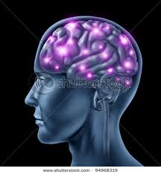
Memory PROCESSES
ENCODING
STORAGE
RETRIEVAL

Slide 28
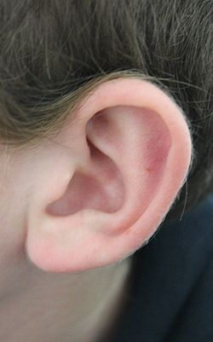
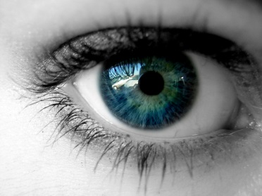
ENCODING MEMORY
CTSA10
How do you remember the musical notes in the spaces?
Repeat letters aloud
Visualize the letters
Think of the
word face
Acoustic code
Visual code
Semantic code

Slide 29
Memory stages
GO10
SENSORY:
Iconic (visual) memory lasts up to a second
Echoic (auditory) memory lasts 1-2 seconds
Also haptic (touch), gustic (taste), olfactic (smell)
Benefits?
(time to process, can keep if wanted, not bombarded)
DEMO (recall as many items on the following slide as possible)

Slide 30
7 1 V F
X L 5 3
B 7 W 4

Slide 32
Memory stages
GO10
SHORT-TERM:
Limited duration (20 seconds) + capacity (7 items)
Transfer to long term:
Involves the Hippocampus
Maintenance rehearsal (repeat phone number)
Chunking (split 10 numbers into 3 groups)
Primary-recency effect (first and last items easier to remember)
Memory lab

Slide 33
Memory stages
GO10
LONG-TERM:
Semantic (knowledge of language and grammar)
Episodic (chronological retention of events of your life)
Declarative (conscious recall of information when needed)
Procedural (learned skills not requiring conscious recall)
Working memory includes short term memory
AND
information recalled from long term memory

Slide 34
Quiz 10-1

Slide 35
Declarative memory
Cortex (storage ST & LT of words, facts & events)
Thalamus (process sensory info)
Amygdala (associate memories with emotions)
Hippocampus (transfer words, facts & events from ST to LT)

Slide 36
Retrieving information
Brain organizes stored information to make it easy to retrieve
Capacity varies (Rajan – recited Pi to 30,000 decimals – can`t find keys or remember faces)
Recognition: identify object, idea, or situation as one you have (not) previously experienced
Recall: reconstruction of previously learned material
DEMO (did you see it?)

Slide 37
Did you see it?
After viewing the tray of familiar items for 15 seconds, recall as many as possible by writing them down
Compare your list to the following and note any discrepancies:
Pen Ruler Chalk Pencil
Stapler Paper clip Tape Eraser
Rubber band Scissors Marker Highlighter
Lips Ear Hat Shoes
Do you recall seeing all of these items now?

Slide 38
Memory alteration
Memory is not a videotape recording
Confabulation = filling in gaps or inventing memories when reconstruction incomplete
Schemas (conceptual framework) affect our reconstruction (recall speed before car contacted or bumped or hit or smashed another car)
About 5 % of children (fewer adults) can recall very specific visual detail after brief exposure = eidetic (aka photographic) memory

Slide 39
Memory retrieval
Relearning = declarative AND procedural memory (poem learned in childhood)
State-dependent (return to place where you remembered)
Forgetting:
Decay = fading away of memory over time
Hypnosis, meditation, brain stimulation can recover “forgotten” memories
Interference = blockage by previous or subsequent memories (phone numbers)
Repression = subconscious blocking of traumatic memories

Slide 40
Memory improvement
Elaborative rehearsal = linking new information to material already known
Mnemonic devices = using associations to memorize and retrieve information (HOMES, EGBDF, method of loci)

Slide 41
Quiz 10-2 Memory and Thought (RA 10) personality, cognition and memory (ea 10) influencing memory (aa 10)

Slide 42
Thinking and problem solving
Thinking = changing and reorganizing the information stored in memory to create new information
Copernicus made a radical assumption about the movement of the planets in the heavens

Slide 43
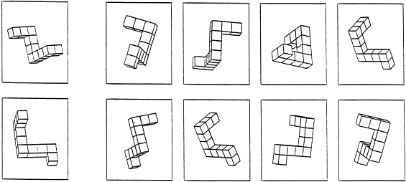
Units of thought
GO11
Image = mental representation of an event or object (most primitive)
Shepard & Metzler mental rotation experiment (1971)

Slide 44
Units of thought
GO11
Symbol = abstract unit of thought that represents an object or quality (most common – words)
Concept = class of objects or events with certain common attributes or the attributes themselves (i.e. animals, music, school subjects, holidays)
Prototype = representative example of a concept (i.e. dog, rap, psychology, Mothers Day)
Rule = statement of a relation between concepts (more complex) (i.e. you can’t be in two places at the same time)

Slide 45
Kinds of thinking
GO11
Directed or convergent: systematic and logical attempt to reach a specific goal, such as the solution to a problem
Depends on symbols, concepts and rules (i.e. math, hunger, poverty, illness)
Nondirected or divergent: free flow of thoughts with no particular goal or plan
Usually rich with imagery and feelings (i.e. daydreams, fantasies, reveries, escaping boredom / worry, unexpected scientific or artistic insights)
Metacognition: awareness of or thinking about one’s own cognitive processes (i.e. changing strategy when problem solving unsuccessful)

Slide 46
Directed vs nondirected thinking
Read psychologist Edward De Bono’s problem aloud
You have 2 minutes to solve it

Slide 47
strategies
Break down a complex problem into subgoals: intermediate steps toward a solution
Algorithm: step-by-step procedure or formula that will always result in the correct solution, although not necessarily the most efficient way (i.e. rules of multiplication, moves in chess, browse contact list)
Heuristic: a general strategy or role of thumb / shortcut, experimental, more flexible but may result in incorrect solution (i.e. crossword puzzles, coin flip prediction)

Slide 48
obstacles
Mental set = habitual strategy or pattern of problem solving:
Rigidity = mental set interferes with problem solving
Problem: connect the dots
Functional fixedness = inability to imagine new functions for familiar objects
Problem: use candle, matchbox, string, tacks to mount candle on wall and light it
Problem: arrange 6 toothpicks to form 4 equilateral triangles

Slide 49
creativity
Creativity: the capacity to use new information and/or abilities in a new and original way
Flexibility = the ability to overcome rigidity and generate original solutions (i.e. uses for a cardboard box)
Recombination = mentally rearranging the elements of a problem to arrive at an original solution (i.e. music, movies, sports, science)
Insight = the apparent sudden realization of the solution to a problem (i.e. chimp & bananas, elephant & leafy branch)

Slide 50
Flexible thinking
Name a single word that all 3 words on a line have in common
1 | Stool | Powder | Ball
2 | Blue | Cake | Cottage
3 | Man | Wheel | High
4 | Motion | Poke | Down
5 | Line | Birthday | Surprise
6 | Wood | Liquor | Luck
7 | House | Village | Golf
8 | Card | Knee | Rope
9 | News | Doll | Tiger
10 | Painting | Bowl | Nail

Slide 51
Flexible thinking
#2 is an example of flexibility
1 | Stool | Powder | Ball | Foot
2 | Blue | Cake | Cottage | Cheese
3 | Man | Wheel | High | Chair
4 | Motion | Poke | Down | Slow
5 | Line | Birthday | Surprise | Party
6 | Wood | Liquor | Luck | Hard
7 | House | Village | Golf | Green
8 | Card | Knee | Rope | Trick
9 | News | Doll | Tiger | Paper
10 | Painting | Bowl | Nail | Finger

Slide 52
Quiz 11-1 problem solving (aa 11)

Slide 53
language
Ever talk to yourself?
We think and speak using language: expression of ideas through symbols and sounds that are arranged according to rules
Language has 3 elements:
Phonemes = an individual sound that is the basic structural element of language
Morphemes = smallest unit of meaning in a given language
Syntax = rules that govern how words can be combined to form meaningful phrases and sentences
Semantics = study of meaning in language

Slide 54
phonemes
We can produce about 100 different sounds
Each sound can be represented by a letter or combination of letters
The International Phonetic Alphabet (IPA) has 40 codes to represent the sounds commonly used in English (other languages have more or fewer)
Use the IPA to write your name

Slide 55
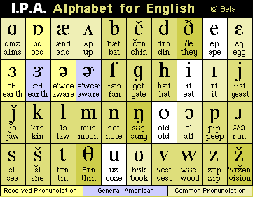

Slide 56
morphemes
The word FEARLESSNESS has 9 phonemes and 3 morphemes:
Fear = an emotion
Less = lack of
Ness = state or condition of
Adding prefixes and/or suffixes change a word’s meaning (undo, sadly)
Compound words blend or augment meaning (backpack, cellphone)
A Portmanteau is a blended word (smog, Wikipedia, stagflation, Brangelina)

Slide 57
Syntax
attended I school year last.
communication language a human is form of.
acquire how language we do?
Reorder each line to form a meaningful sentence.
Are there any other acceptable combinations?
How do syntax rules help us understand each other?

Slide 58
Semantics
Have I got a lot of homework?
Have I got a lot of homework!
A mind is a terrible thing to waste.
Do you mind if I sit beside you?
What is the difference between the first two sentences? What semantic clues helped you interpret their meaning?
How is mind used differently?

Slide 59
Language development
B.F. Skinner: children learn language through operant conditioning
Noam Chomsky: infants possess an innate capacity for language, a mental program that enables them to learn language
Benjamin Whorf: language influences thought = linguistic relativity (Inuit many words for snow, gender stereotypes)
Babies babble, then single words, then telegraphic speech, etc.
Animals communicate but do not use grammar

Slide 60
Language practice
Read Shakespeare
Do crossword puzzles
Play Wheel of Fortune
Learn to sign (ASL, etc.)
Learn a new language

Slide 61
Language practice
Aoccdrnig to rscheearch at an Elingsh uinervtisy, it deosn't mttaer in waht oredr the ltteers in a wrod are, olny taht the frist and lsat ltteres are at the rghit pcleas. The rset can be a toatl mses and you can sitll raed it wouthit a porbelm. Tihs is bcuseae we do not raed ervey lteter by ilstef, but the wrod as a wlohe.

Slide 62
Quiz 11-2 thinking and language (ra 11) creativity (ea 11)

Slide 63
motivation
Kerri Strug helped US team win gold at 1996 Olympics – landed the vault with sprained ankle
What can be accomplished when motivated?
Motivation = internal state that activates behavior and directs it toward a goal
Motives can be inferred from goal-directed behavior
Four theories: instinct, drive-reduction, incentive, cognitive

Slide 64
Instinct theory
Instinct = innate tendencies that determine behavior:
Salmon swim back to spawn
People also have instincts: cleanliness, curiosity, parental love, sociability, sympathy
Flawed theory that simply labels but doesn’t explain behavior

Slide 65
Drive-reduction theory
Clark Hull traced motivation back to basic physiological needs
Need = biological or psychological requirements of an organism
Drive = state of tension produced by a need that motivates an organism toward a goal
Some experiences (i.e. contact comfort) satisfy psychological (but not biological) needs (i.e. Harry Harlow’s monkey experiment)
Some activities increase tension (i.e. roller coaster, horror film)

Slide 66
Incentive theory
Incentive theory stresses the role of the environment (vs drive reduction theory’s focus on internal states)
Incentive = external stimulus, reinforcer, or reward that motivates behavior

Slide 67
Cognitive theory
Extrinsic motivation = engaging in activities that either reduce biological needs to help us obtain external incentives
Intrinsic motivation = engaging in activities because they are personally rewarding or because they fulfill our beliefs and expectations
Overjustification effect = when people are given more extrinsic motivation that needed their instinsic motivation declines (i.e. read for enjoyment…paid to read...payment stops…reading stops)

Slide 68
Quiz 12-1

Slide 69
Biological motives
Homeostasis = tendency of an organism to return to or maintain a normal state
Examples: food, water, oxygen, sleep, avoid pain
Why do we eat?
Rat experiment (handling…eating)
Hunger or other factors?
Pancreas releases insulin to convert calories to energy

Slide 70
hunger
Motivation to begin eating
Motivation to stop eating
Internal | External
Blood glucose level drops | Time of day
Activity in Lateral Hypothalamus (LH) | Appealing food smell
Set-point for body weight | Attractive food appearance
Empty stomach | Social setting
Boredom / stress | Boredom / stress
Internal | External
Blood glucose level rises | Time of day
Activity in Ventromedial Hypothalamus (VMH) | Unpleasant food smell
Set-point for body weight | Unattractive food appearance
Full stomach | Social setting

Slide 71
hypothalamus
Hypothalamus interprets:
Amount of glucose (glucostatic theory of hunger)
Set-point
Body temp (cold stimulates LH…eat, heat stimulates VMH…don’t eat)
Removal of LH…starvation
Damaged VMH…morbid obesity
Most obese people respond to external cues

Slide 72
Social motives
Achievement motive = desire to set challenging goals and persist in trying to reach them despite obstacles, frustrations and set-backs
High achievers prefer experts who will help them achieve instead of more friendly people
Fear of failure – may make excuses to explain poor performance
Fear of success:
affects both men and women
highly intelligent women with real chance of achievement have stronger fear of success than average women according to Horner
Expectancy-value theory = people are motivated when they think they can succeed and the goal is worth a lot to them

Slide 73
Maslow’s heirarchy
Fundamental needs = biological drives that must be satisfied to maintain life
Psychological needs = urge to belong and to give and receive love and the urge to acquire esteem
Self-actualization needs = pursuit of knowledge and beauty or whatever else is required for the realization of one’s unique potential

Slide 74
Quiz 12-2 motivation (GO 12)

Slide 75
emotions
Motivations and emotions usually linked
Emotion = a set of complex reactions to stimuli involving subjective feelings, physiological arousal, and observable behavior
Emotional intelligence = ability to perceive, imagine and understand emotions and use that information in decision making
Key asset in leadership
Damage to prefrontal cortex…no emotion…problems deciding

Slide 76
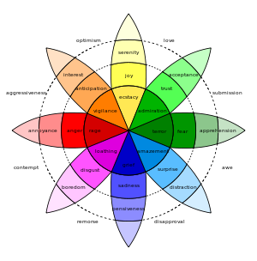

Slide 77
Expressing emotion
All emotions have 3 parts: physical, behavioral, cognitive
All people express certain basic feelings in the same way (Darwin)
Must be innate (blind babies laugh, pout & frown)
Facial Feedback = specific inherited facial expressions that signal specific feelings or emotional states
Seven universally recognized facial expressions of emotions

Slide 78
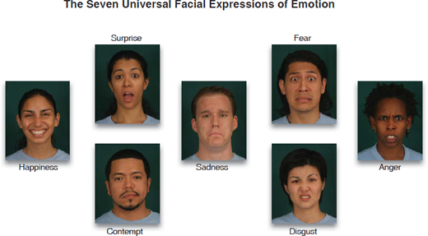

Slide 79
Expressing Emotions
Learning is an important factor
Many of our everyday emotional reactions are the result of social expectations and consequences (Averill)
Few people (10-20%) can hide true emotions (Ekman)
Learning explains the differences among people:
Everyone feels emotions the same but women express them more
North Americans tend to speak their mind while many eastern cultures defer to authority

Slide 80
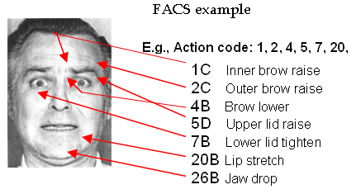
Ekman’s facial action coding system
46 separate movements

Slide 81
theories
James-Lange | Facial Feedback | Cannon-Bard | Schacter-Singer | Opponent-Process
Experience physical changes | Facial muscles move to form an expression | Experience activates thalamus (hypothalamus) | Experience physical arousal | Emotional responses classically conditioned
Brain interprets changes | Brain interprets movement (paralysis ?) | Messages to cerebral cortex and organs | Perceive environmental cues | Stimulus that excites the emotion is removed
Feel a specific emotion | Feel an emotion | Organs activate sensory signals | Feel an emotion | Feel a swing to the opposite emotion
Demonstrate observable behavior | Demonstrate observable behavior | Sensory signals + cortical message = emotion | Demonstrate observable behavior | Demonstrate observable behavior

Slide 82
Everyday emotions
How do we “read” the moods of people we know well?
Could you go 10 hours without expressing emotion?
Why do people use emoticons in emails?
Lie detection methods:
Rice in mouth
Polygraph is unreliable: arousal of sympathetic nervous system (BP, heart rate, breathing, galvanic skin response)
“Pay it Forward” by Elizabeth Svoboda (Psychology Today, July 2006)

Slide 83
Quiz 12-3 motivation and emotion (RA 12) detecting lies (EA 12) meeting needs motivates behavior (AA 12)

