Slide 1
Personality and Individuality
Psychological Testing

Slide 2
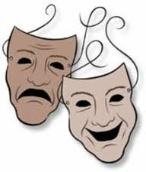
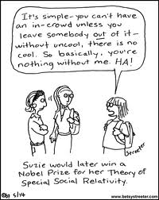
What do you know?
What do we mean by Personality?
Consistent, enduring, unique characteristics
What constitutes Individuality?
Differences in the way people think, feel and act
Personare = to speak through

Slide 3
Learning Outcomes
PERSONALITY AND ASSESSMENT Explain personality as the individual's unique way of thinking, feeling, and acting. Explain the characteristics of the psychodynamic, cognitive-behavioral, humanistic, and trait approaches. Describe and assess various forms of personality assessment. | INDIVIDUAL DIFFERENCES Explain how intelligence and personality may be influenced by heredity and environment. Describe theories of intelligence. Explore how intelligence is measured.

Slide 5
Reliability
Results are consistent:
When test repeated soon (test-retest)
When test marked at different times (scorer)
When test marked by different people (interscorer)
When test divided in half and marks compared (split-half)

Slide 6
Validity
Test measures what it is intended to measure
Test accurately predicts performance

Slide 7
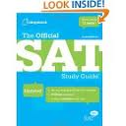
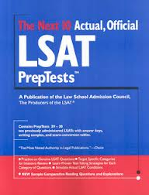
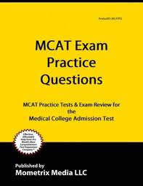
Standards for Comparison
Raw score plotted on percentile scale
Results relevant in comparison to others
Norms are established by:
large group of test takers
standardized tests (administration and scoring)…provincials exams and…

Slide 8
Quiz 13-1

Slide 9
Consider these people…

Slide 13
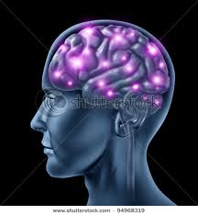
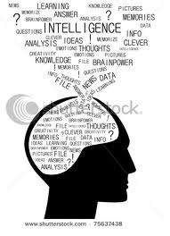
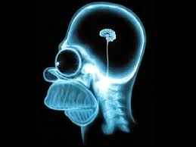
What is Intelligence?
The ability to acquire new ideas and new behaviour and adapt to new situations
Graphic Organizer 13 “Theories of Intelligence”

Slide 14
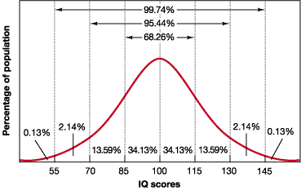
Binet
Mental age / chronological age x 100
Test questions get different results by age
Original intent – identify slow learners for “special ed” class
Issues: cultural bias and nature vs nurture

Slide 15
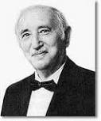
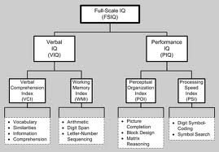
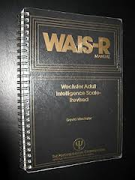
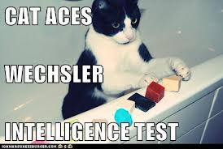
Weschler
Weschler test (children)
WAIS-R test (adults)

Slide 16
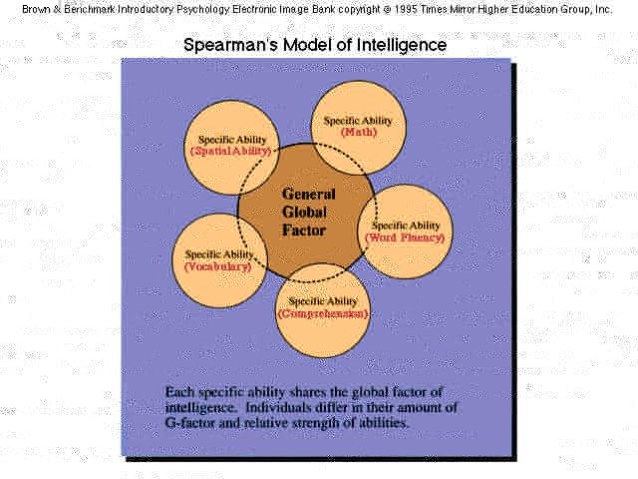
Spearman
Two Factor: general intelligence + specific mental abilities

Slide 17
Sternberg
Triarchic Theory:
Analytical, Creative, Practical

Slide 18
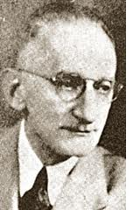
Thurstone
Verbal comprehension
Numerical ability
Spatial relations
Perceptual speed
Word fluency
Memory
Inductive reasoning
Seven Primary Mental Abilities

Slide 19
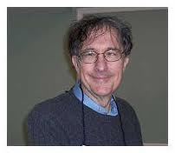
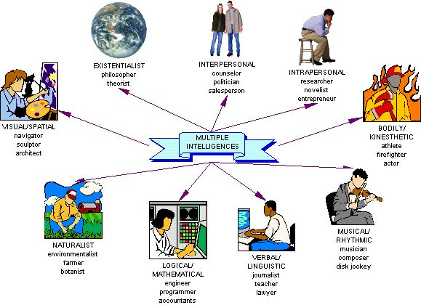
Gardner

Slide 20
Emotional (EQ)
Perceive and express emotions accurately and appropriately
Use emotions while thinking
Understand emotions and use the knowledge effectively
Regulate one’s emotions to promote personal growth

Slide 21
Quiz 13-2

Slide 22
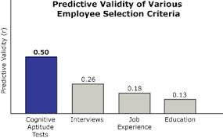
Aptitude
Test quality based on predictive validity
GATB – verbal, mathematical, manual skills (wide range of occupations)
Admissions testing

Slide 23
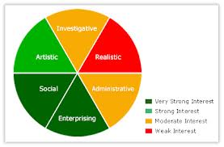
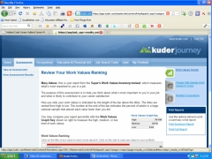
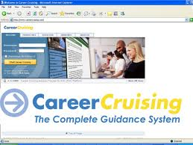
Interest Inventory
No “wrong” answers
Compare your responses to those of people in a particular occupation
Kuder Preference Record – preferences and attitudes
Career Cruising – career planning website

Slide 24
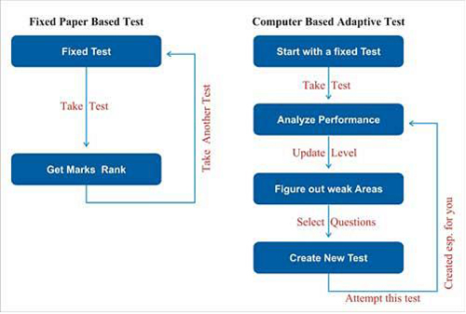
Achievement
Test quality based on content validity
Achievement = what you have done
Aptitude = what you can/might do
Interest – what you would enjoy doing
Adaptive testing (computer based) finds difficulty level where most but not all answers correct…more accurate than standard testing
…take an achievement test now

Slide 25
Quiz 13-3

Slide 26
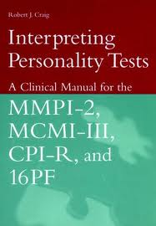
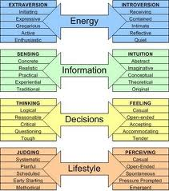
Personality
Objective tests (forced choice answers):
MMPI - major patterns of personality and emotional disorders, diagnose psychiatric disorders
CPI - responsibility, self-control, tolerance
MBTI aka Myers-Briggs

Slide 27
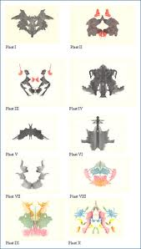
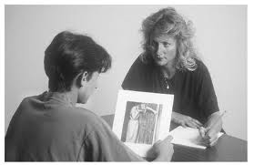
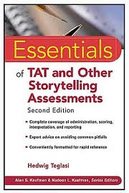
Personality
Projective tests (open-ended):
Rorschach – interpret inkblots (any response will reveal personality)
TAT – interpret scenes on cards

Slide 28
Quiz 13-4

