Slide 1
Personality and Individuality
Theories of Personality

Slide 2
Why do we create theories?
Looking for patterns in the way people behave
Explain differences, considering:
Motives (i.e. want recognition)
How motives were established (i.e. winning has led to recognition)
Underlying issues (i.e. childhood conflict - demanding parent)

Slide 3
What questions do personality theorists ask?
Why do problems arise?
Why are problems more difficult for some people than others?
How can lives be improved?

Slide 4
Major Personality Theories
Psychoanalytic
Unconscious motives: Freud, Jung, Adler
Learning
Behaviorist (Rewards and punishment): Skinner
Social learning (Observation): Bandura
Humanistic / Cognitive
Personal growth: Maslow
Thoughts, perceptions & feelings: Rogers, Kelly
Trait
Characteristics: Allport, Cattell, Eysenck
Graphic Organizer 14 “Theories of Personality”

Slide 5
Quiz 14-1

Slide 6
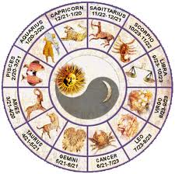
What’s Your Sign and Does it Matter?
Is there a correlation between birth month and personality?
Work in groups of 4
Create a hypothesis
Conduct the experiment and record data
Analyze the results and assess the experiment
Share your findings

Slide 7
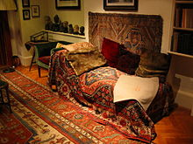
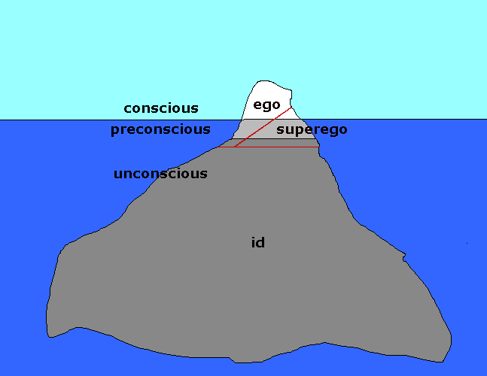
Psychoanalytical Theories
Unconscious mind stores memories that influence behavior
Basic personality formed in childhood
Mind has three levels:
Id (instinctual and biological urges)
Ego (in touch with reality, mediates)
Superego (moral principles)
Ego protects itself using defense mechanisms

Slide 8
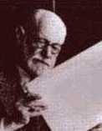
Defense Mechanisms
Rationalization (make excuses)
Repression (deemphasize problem)
Denial (don’t accept situation)
Projection (attribute own view to others)
Reaction formation (compensate)
Regression (act immaturely)
Displacement (take frustration out on low risk target)
Sublimation (work off frustration productively)
Freud

Slide 9
Defense Mechanisms
Good or bad?
Relieve stress, help weather crisis, time to work out problems
Distort reality, avoid problems

Slide 10
Freud’s context
Victorian era (19th century)
Morality, PDA’s and sex talk prohibited
Led to repressed feelings & sexual desires
Pushed into unconscious
Emerge as cutting remarks, sarcasm, dreams, slips of the tongue
Freudian slips (dimples, alto sax, simulator)
Psychoanalyst “shrinks” patient back to childhood to unlock repression

Slide 11
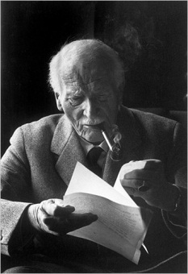
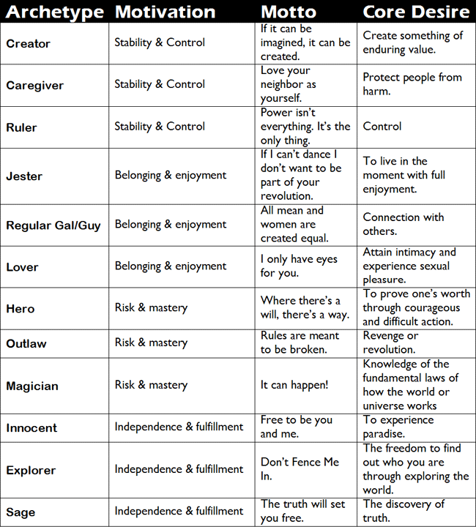
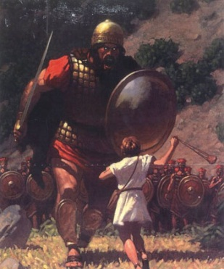
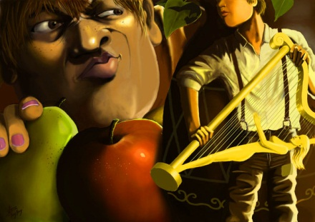
Jung
Collective unconscious: storehouse of instincts, urges, and memories of entire human species throughout history
Archetypes: inherited, universal ideas

Slide 12
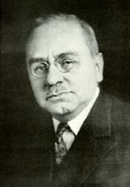
Adler
Driving force = desire to overcome feeling inferior
Inferiority complex = avoiding feelings of inadequacy rather than working on source problem

Slide 13
Quiz 14-2

Slide 14
What would Freud do?
Analyze the 8 situations described in your booklet
Select a defense mechanism he might employ in each situation
Describe how it might unfold
Share your responses

Slide 15
Learning Theories
Personality is learned
Different experiences…different personality

Slide 16
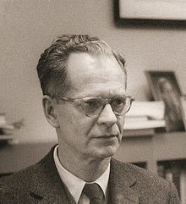
Behaviorism
Behavior can be predicted and controlled
Contingencies of reinforcement (rewards & punishments)
Skinner

Slide 18
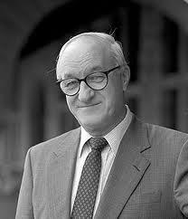
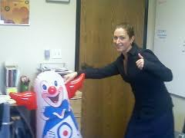
Social Cognitive
We observe and imitate models of choice
Reciprocal determinism (individual + behavior + environment)
Individual: beliefs, expectations (self-efficacy), emotions, genetics, social roles…
Bandura

Slide 19
Quiz 14-3

Slide 20
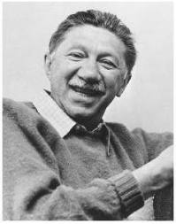
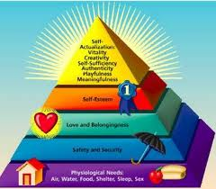
Humanistic Theories
Studied successful people…not seeking treatment
Human nature basically good
Personal growth toward potential (self-actualization)
Maslow

Slide 21
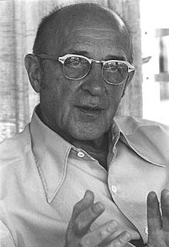
Cognitive Theories
Need positive regard (approval)
Self = our image of who we are & what we value
Self and person in synch…fully functioning
Conflicts from conditions of worth (judgements)
Unconditional positive regard
Rogers

Slide 22
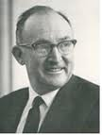
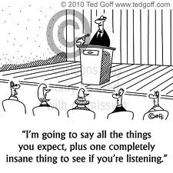
Cognitive Theories
Based on analysis of our own perceptions, thoughts and feelings
Personal construct theory = how we behave based on predictions about the world
Schemas = mental representations of people, events and concepts
Kelly

Slide 23
Quiz 14-4

Slide 24
Self-Actualization
Application Activity 14

Slide 25
Trait Theories
Trait = behaviors that characterize individuals
Every trait applies to all people (i.e. dependence or aggression)
Descriptions can be quantified (i.e. on a scale of 1 to 10)

Slide 26
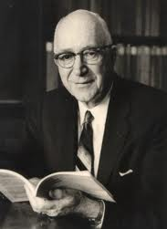
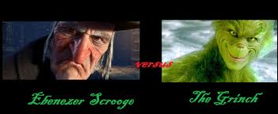
Allport
Probed the dictionary
Cardinal trait = pervasive, identifying
Central trait = predictable
Secondary trait = preference
Traits consistent across situations

Slide 27
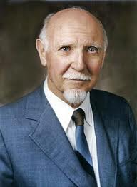
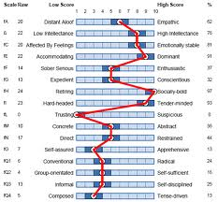
Cattell
Factor analysis
46 surface traits
16 source traits

Slide 28
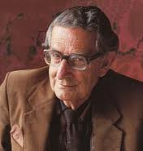
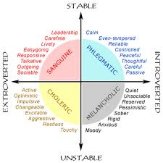
Eysenck
Dimensions:
Stability vs instability
Extroversion vs introversion
Psychoticism:
Self-centered, hostile, aggressive
Sensitive, caring, empathetic, easy going

Slide 29
Robust Five (aka Big Five)

Slide 30
Quiz 14-5

Slide 31
Personality Traits
Project 14-1

