Slide 1
What is Psychology?

Slide 2
Psychology = the scientific study of behavior and mental processes.

Slide 3
Why should we study Psychology?

Slide 4
Psychology can help us
understand our own behavior
understand social dynamics
understand we aren’t alone in our feelings
understand how to train / use incentives
understand how we learn / use memory tools…

Slide 5
BUT behavior is complex!
Why do we do what we do?
How do we study behavior?

Slide 6
For example:
You tell a friend your boss is weird. What will your friend want to know?

Slide 7
Or:
You tell your doctor you think you are going crazy. What will the doctor want to know?

Slide 8
Psychologists have 4 GOALS:
1. Describe Behavior

Slide 9
Test your observation skills
Activity 1:
Observe your classmates for 1 minute.
Record all observable behaviors. Discuss.
Activity 2:
In pairs, walk about the school.
Participant leads, mentally noting observable behaviors.
Experimenter follows, recording observable behaviors.
Experimenter creates and asks 10 questions.
Calculate score out of 10 and analyse results.

Slide 10
But that still doesn’t tell us WHY we do what we do.
Ancient people had ideas…

Slide 11
The gods made me do it!

Slide 12
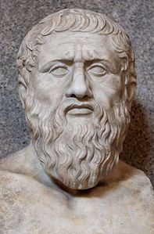
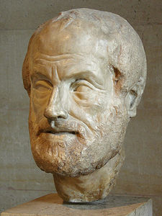
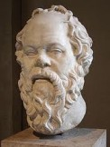
Greek philosophers decided people have MINDs and control their own behavior.
Plato
Aristotle
5th Century BC
Socrates

Slide 13
But what is the MIND?
Dualism = theory that mind and body are distinct and separate.

Slide 14
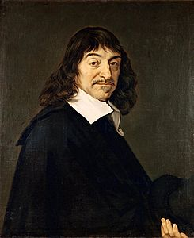
Rene Decartes argued the mind and body are distinct but must be linked.
17th Century
“Cogito Ergo Sum” = I think therefore I am

Slide 15
The term Psychology was first used in 1853
Elements of Psychology
By J D Morell

Slide 16
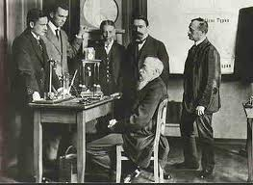
The first lab was set up to study Psychology in 1879.
Wilhelm Wundt
“Father of Experimental Psychology”

Slide 17
Wundt enabled Psychologists to reach another GOAL:
2. Explain Behavior

Slide 18
How did Wundt study cognitive (private, unobservable mental) behaviour?
People self-report their thoughts and feelings using introspection (look inside).

Slide 19
Introspection
Scientific Method

Slide 20
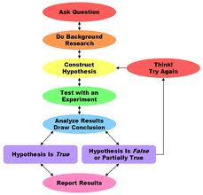
The Scientific Method

Slide 21
What is the difference between a Hypothesis and a Theory?

Slide 22
Hypothesis = educated guess about behavior that is tested through scientific research
For example: Teens who rely heavily on electronic communication have more difficulty with interpersonal relationships.

Slide 23
Theory = a complex explanation based on many scientific studies
For example: Related theories are that teens use electronic communication because there are immediate rewards (behaviorism theory) and/or because their peers do (social learning theory), and rationalize (psychoanalytic theory) the limitations.

Slide 24
When Psychologists have a THEORY, they can reach another GOAL:
3. Predict Behavior

Slide 25
Basic Science = pursuit of knowledge for its own sake
For example:
A Psychologist studies the effects of antidepressant medication on adolescents. Results (predicted behaviors and outcomes) are published.

Slide 26
Other Psychologists use these theories to reach the last GOAL:
4. Influence Behavior

Slide 27
Applied Science = using psychological principles to solve problems
For example:
A Psychologist is counselling an adolescent who meets the diagnostic criteria for major depressive disorder. Research studies have not shown antidepressant medication to be beneficial but have shown increased suicidal risk in adolescents. Other treatment options are pursued.

Slide 28
Section Quiz 1-1

Slide 29
You are probably asking yourself how many theories about behavior are there?
How many can you name/describe?
Think about all the different reasons you behave the way you do.

Slide 30
There are
4 Historical
and
6 Contemporary
Approaches
Use Graphic Organizer 1 to document them

Slide 31
HISTORICAL

Slide 32
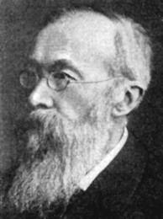
Structuralism
Human experience can be broken down into basic elements of consciousness
Wundt
(1832-1920)
Introspection

Slide 33
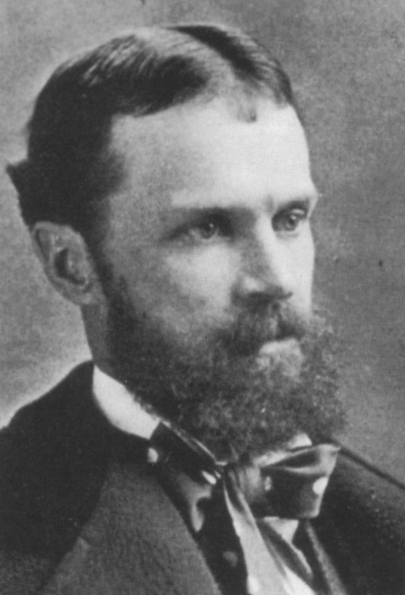
Functionalism
People and animals adapt to their environments. Behaviors help them survive.
William James
(1842-1910)
“The greatest discovery of my generation is that a human being can alter his life by altering his attitudes.”

Slide 34
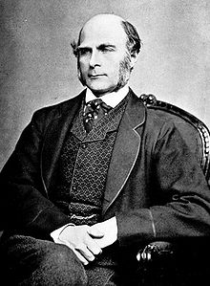
Inheritable Traits
Heredity influences ability, character, and behaviour.
Sir Francis Galton
(1822-1911)
Genius/greatness runs in families.
Nature vs Nurture
Eugenics
Personality Testing
First to use questionnaires and surveys.

Slide 35
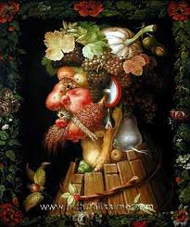
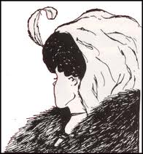
Early 20th century
German psychologists
Gestalt = whole form
Sensations are assembled into perceptual experiences.
The whole is greater than the sum of its parts.
Figure-ground perception

Slide 36
CONTEMPORARY

Slide 37
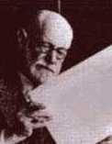
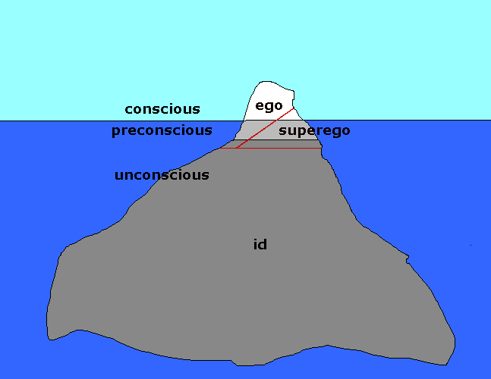
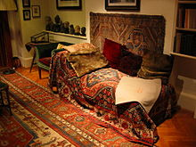
Psychoanalytic Psychology
Unconscious motives and conflicts determine human behaviour.
Sigmund Freud
(1856-1939)
Dream Analysis
Intensive Case Study
Free Association
Freudian Slip

Slide 38
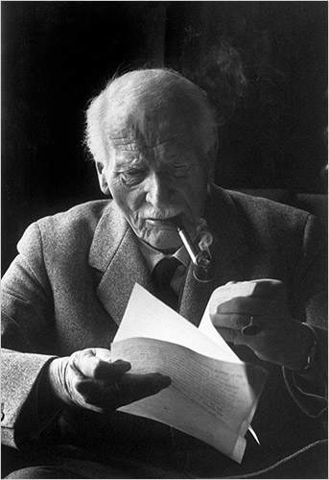
Psychoanalytic Psychology
Unconscious motives and conflicts determine human behaviour.
Carl Jung
(1875-1961)
Collective Unconscious
Archetypes
(Self, Shadow, Anima, Animus, Persona)
(wise old man, mother, hero)

Slide 39
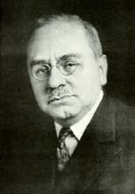
Psychoanalytic Psychology
Unconscious motives and conflicts determine human behaviour.
Alfred Alder
(1870-1937)
Inferiority Complex

Slide 40
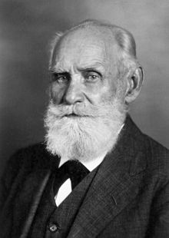
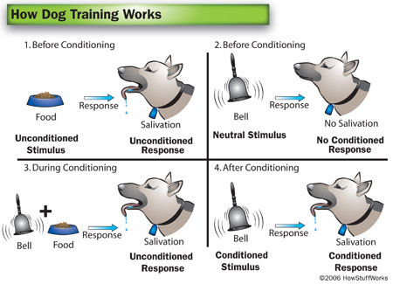
Behavioural Psychology
Behavior is learned or modified in response to the environment.
Ivan Pavlov
(1849-1936)
Classical
Conditioning

Slide 41
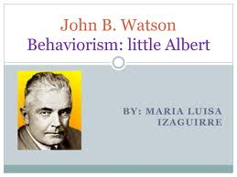
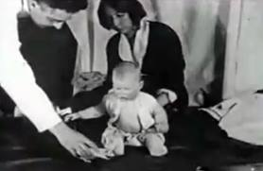
Behavioural Psychology
Behavior is learned or modified in response to the environment.
John Watson
(1878-1958)
Only observable behaviour (not the unconscious) should be studied.
Conditioning
Little Albert

Slide 42
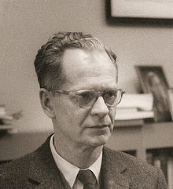
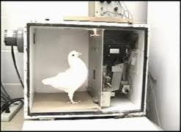
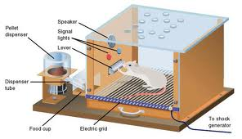
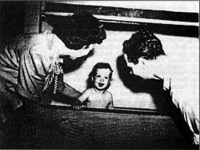
Behavioural Psychology
Behavior is learned or modified in response to the environment.
B F Skinner
(1904-1990)
Operant
Conditioning
Reinforcement
Contingencies Schedules
Skinner Box
Walden Two

Slide 43
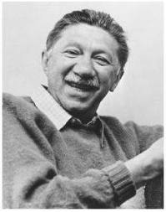
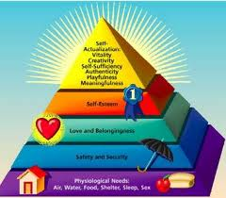
Humanistic Psychology
Human behavior is self-directed.
Self- Actualization
Abram Maslow
(1908-1970)
Hierarchy of Needs

Slide 44
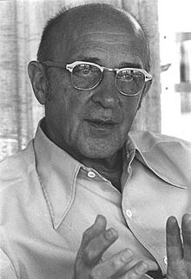
Humanistic Psychology
Human behavior is self-directed.
Carl Rogers
(1902-1987)
Self
Conditions of Worth
Unconditional Positive Regard

Slide 45
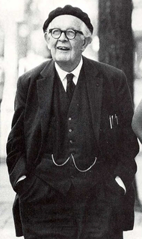
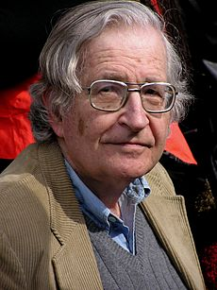
Cognitive Psychology
Human behaviour is rationally motivated, based on mental processes (how information is processed, stored, retrieved and used).
Perception Memory Thinking Speaking Problem Solving
Intellectual development
Language development
Jean Piaget
(1896-1980)
Noam Chomsky
(1928- )

Slide 46
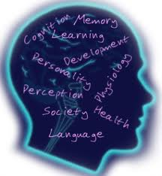
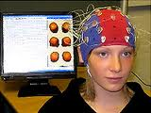
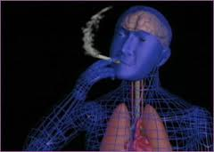
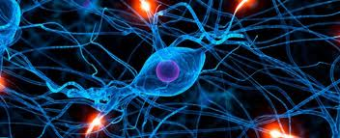
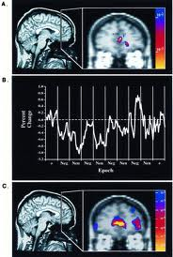
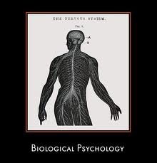
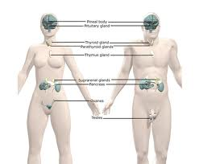
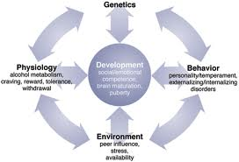
Psychobiology
Physiological changes influence behaviour.

Slide 47
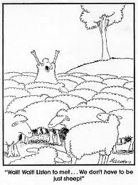
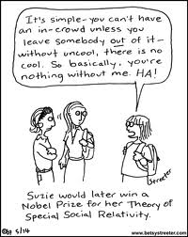
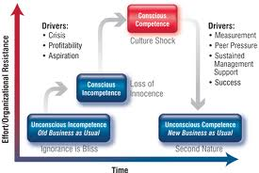
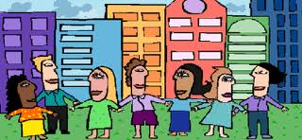
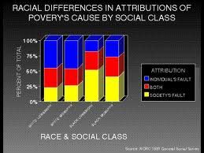
Sociocultural Psychology
Ethnicity, gender, culture, and socioeconomic status influence behaviour.

Slide 48
Section Quiz 1-2

Slide 49
So what exactly do Psychologists do?

Slide 50
Psychologists are trained to:
Observe, analyse and evaluate behaviour
Develop theories of behaviour
Apply knowledge to influence behaviour

Slide 51
Psychologists have a PhD but are not medical doctors.
Psychiatrists are medical doctors who treat people with psychological disorders. Treatment may include surgery or Rx medication.

Slide 52
Most psychologists study everyday behaviours.
Psychologists work in a variety of settings. Where do you think?

Slide 53
Clinical psychologist – diagnoses and treats people with psychological disorders
Most common
Counselling psychologist – usually works in schools or business to help people with everyday problems
Developmental psychologist – studies changes in behaviour (emotional, physical, cognitive, language, social, moral) as people mature
Educational psychologist – studies learning
Community psychologist – works in mental health clinic or social welfare agency
Industrial / organizational psychologist – works to improve workplace, guides training and evaluation, evaluates employee behaviour

Slide 54
Experimental psychologist – tests sensation, perception, learning, motivation, emotion in a carefully controlled lab
Biological psychologist (psychobiolgist) – studies the brain and nervous system using imaging technology
Environmental psychologist – studies the effects of the environment on society and health
Forensic psychologist – works in the legal system (i.e. expert witness) or criminal behaviour (profiler)
Health psychologist – studies the link between physical and mental health
Divisions of the APA or CPA = specialties

Slide 55
Section Quiz 1-3

