Slide 1
RESEARCH
Methods
Problems and Solutions
Statistical Analysis

Slide 2
What’s the first step?

Slide 3
Ask a QUESTION about behavior

Slide 4
Questions a psychologist might ask:
Are young children less likely to obey rules when adults are not present?
What is the appropriate age level for a new toy?
How do young children react when separated from their primary caregivers and among strangers?
What percentage of Canadian teenagers have a depressive disorder, compared to the overall population?
Do people’s attitudes toward teenage behaviour differ by age group?
What happens during sleep?
How can memory be improved?

Slide 5
Develop a HYPOTHESIS
What have other studies shown?
Take an educated guess
Test it using the scientific method
When a hypothesis has been tested repeatedly, by several researchers, and supported by results gained ethically and without bias, a THEORY emerges

Slide 6
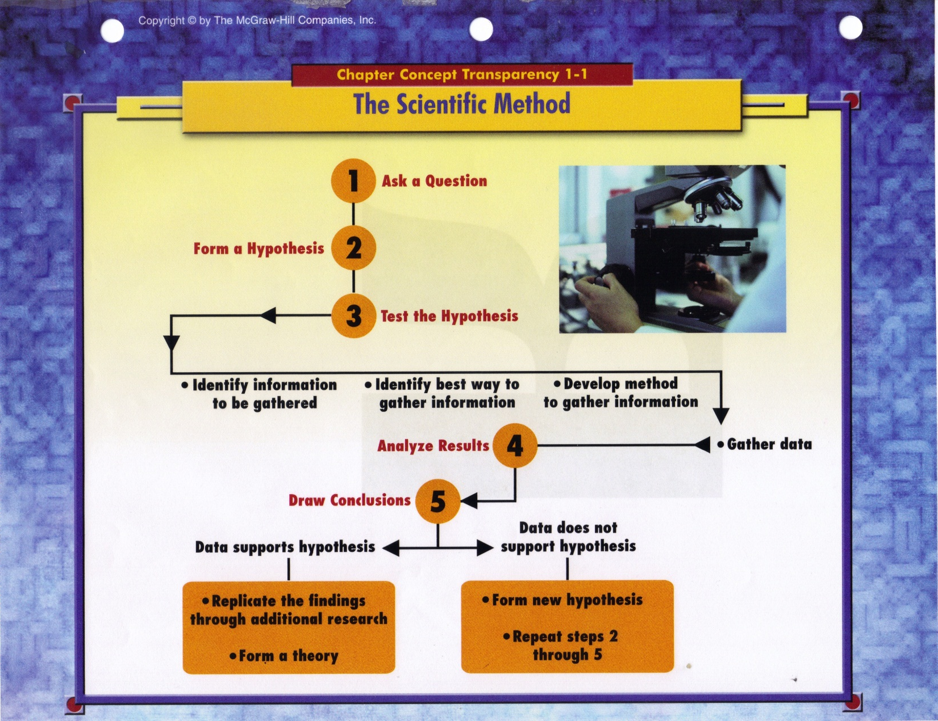

Slide 7
WHO should we test?
Impractical to test the entire population
Select a sample that is representative
Consider size and demographics (age, sex, location, socioeconomic, education…)
Consider method of selection (random)
Consider subgroups (stratified sample)
No bias

Slide 8
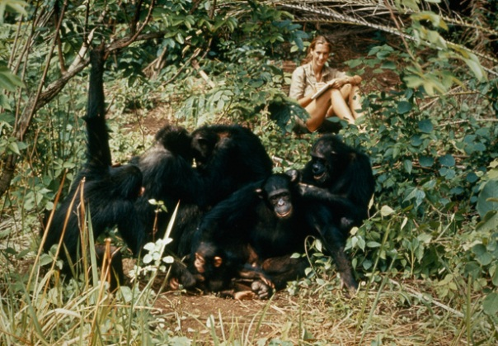
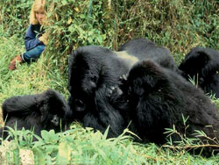
HOW should we test?
Use Graphic Organizer 2 to document the methods
Naturalistic Observation:
Normal environment
Undetected

Slide 9
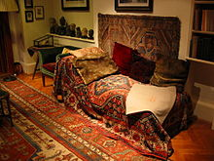
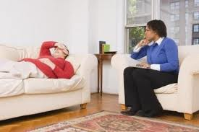
HOW should we test?
Case Study:
Intensive
Interactive
One or few participants
Freud’s couch
Diaries
Tests
Interviews

Slide 10
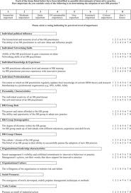
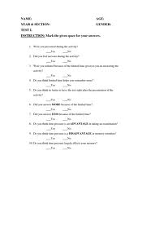
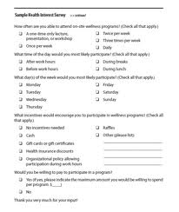
HOW should we test?
Survey:
Standard questions
Forced choice
Paper/internet/ telephone/in person
Many participants

Slide 11
HOW should we test?
Longitudinal study:
How do behaviors changes over time?
Same participants over a period of many years
Difficult to maintain
New York Longitudinal Study 1956:
Studied 133 newborns for 32 years
Children are born with different temperaments
Link

Slide 12
HOW should we test?
Cross Sectional study:
How does behavior differ based on age?
Participants represent different age groups
Groups randomly sampled
“Young Children’s Knowledge About Thinking” (Flavell, Green and Flavell, 1995):
Studied 3, 4, 5 and 6 year olds observing a serious female face
Older children have a clearer view of mental processes

Slide 13
HOW should we test?
Correlational study:
How do two variables relate to each other?
Both increase = positive correlation
One increases other decreases = negative correlation
Correlation coefficient shows direction and strength

Slide 14
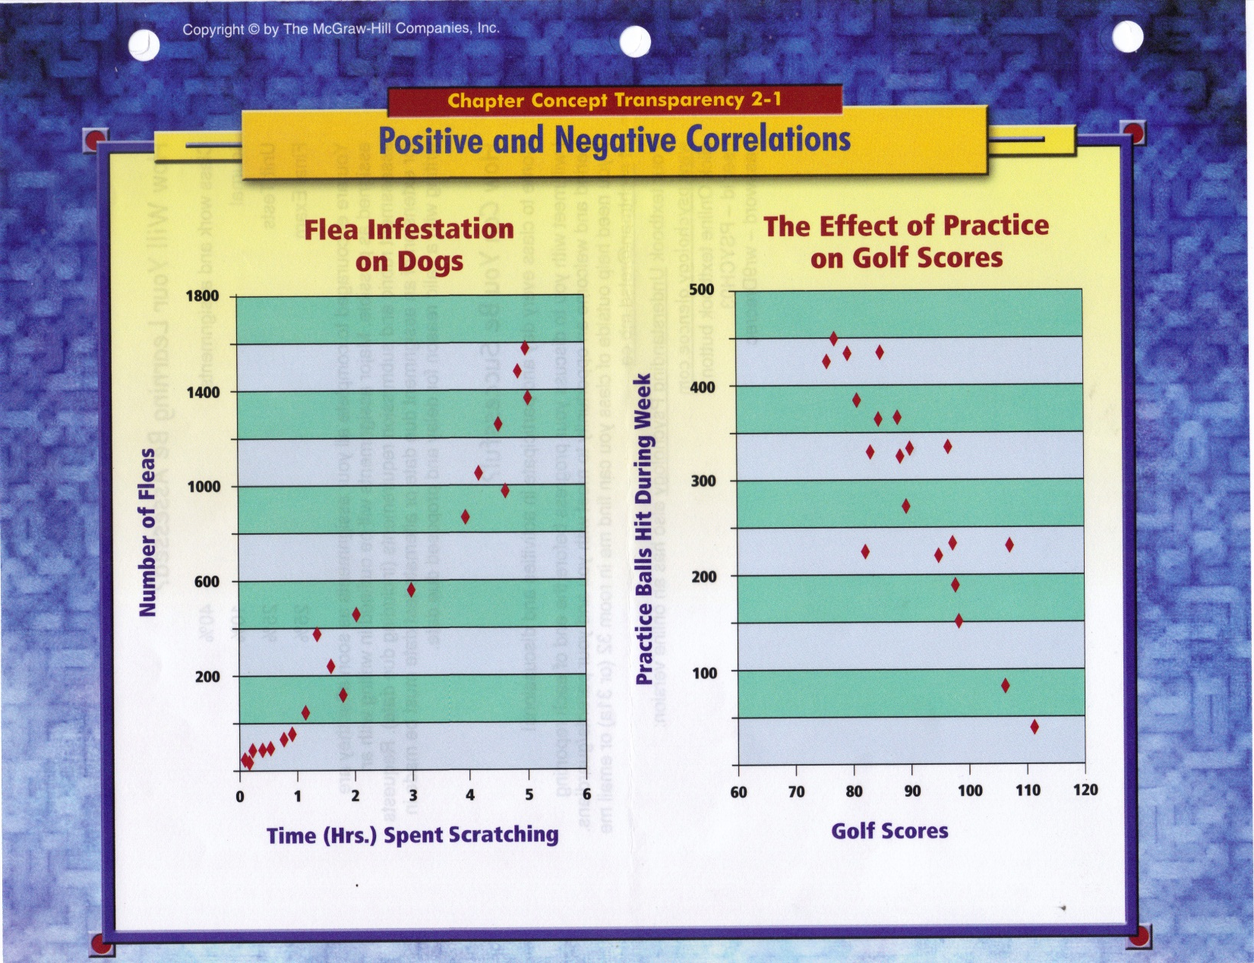
Complete the worksheet in your booklet

Slide 15
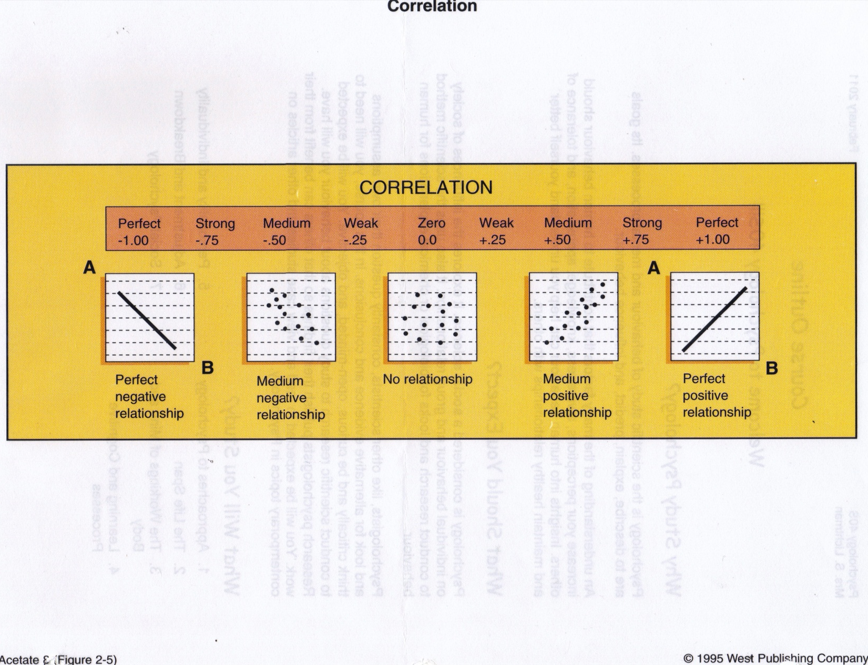

Slide 16
HOW should we test?
Experiment:
Controlled environment and conditions
Independent variable – researcher applies to Experimental group
Control group – same conditions but no independent variable (perhaps placebo)
Dependent variable – behavior (change) being measured

Slide 17
Famous Psychology Experiments
Pavlov's Dogs: How Ivan Pavlov Discovered Classical Conditioning
The Little Albert Experiment
The Asch Conformity Experiments
Harry Harlow's Social Isolation Experiments
The Milgram Obedience Experiment
The Stanford Prison Experiment
Bandura's Bobo Doll Experiment
Link

Slide 18
Ethics
Focus is ethics pertaining to research
2002 APA version of Ethical Principles of Psychology and Code of Conduct
Link

Slide 19
Section Quiz 2-1

Slide 20
So what can go wrong?

Slide 21
Problems and Solutions
Self-fulfilling prophecy = researcher influences behavior being studied
Placebo effect = participant’s expectations influence behavior being studied
Studied hospital psychiatric patients in 1961
Two groups: tested new tranquilizer or energizer
53-80% reported expected benefit
All had received a placebo
Single blind = participants don’t know who is exposed to independent variable
Double blind = neither participants nor research assistant know who exposed to independent variable

Slide 22
Two Famous Studies
The Stanford Prison Experiment
The Milgram Obedience Experiment
Link
Ethical concerns???

Slide 23
Section Quiz 2-2

Slide 24
Statistics
Branch of mathematics – summarize and infer
Used to analyse results
Commonly used by advertisers, sports analysts, insurers
Third goal of psychology = PREDICT behavior…What is the probability of…

Slide 25
What is the probability of two people having the same birthday?
Group of 23 %
Group of 30 %

Slide 26
What is the probability of two people having the same birthday?
Group of 23 50%
Group of 30 95%

Slide 27
Descriptive Statistics
Frequency distribution (histogram, normal / bell curve)
Measures of central tendency:
Mean = average
Median = middle
Mode = most frequent
Measures of variance:
Range = spread (variability)
Standard deviation = average distance from mean

Slide 28
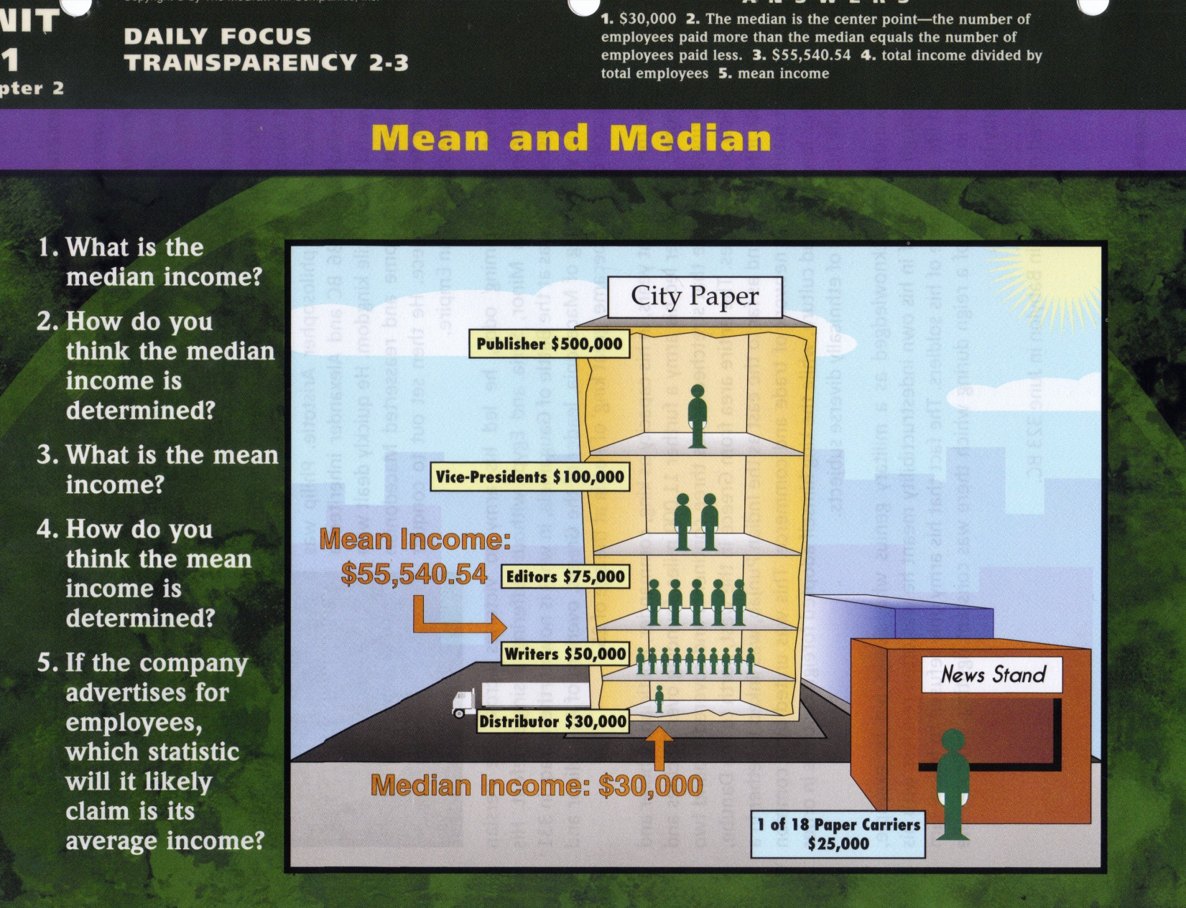

Slide 30
Inferential Statistics
Do the results support the hypothesis or are they simply due to chance outcomes?
Probability and Chance
Statistical Significance

Slide 31
Section Quiz 2-3

